Slide 1
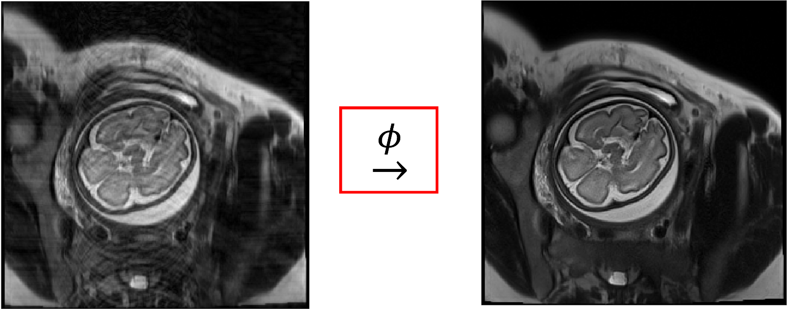

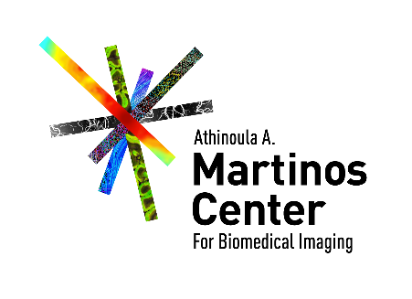

A Machine Learning Approach for Mitigating Artifacts in Fetal Imaging due to an Under-sampled HASTE Sequence
Sayeri Lala¹, Borjan Gagoski², Jeﬀrey N. Stout², Bo Zhao³, Berkin Bilgic³, Ellen P. Grant², Polina Golland¹, and Elfar Adalsteinsson¹

Slide 2
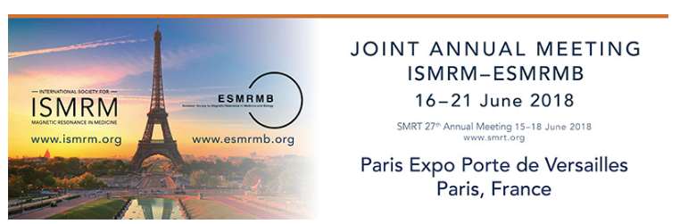
Declaration of Financial Interests or Relationships
Presenter Name: Sayeri Lala
I have no financial interests or relationships to disclose with regard to the subject matter of this presentation.

Slide 3
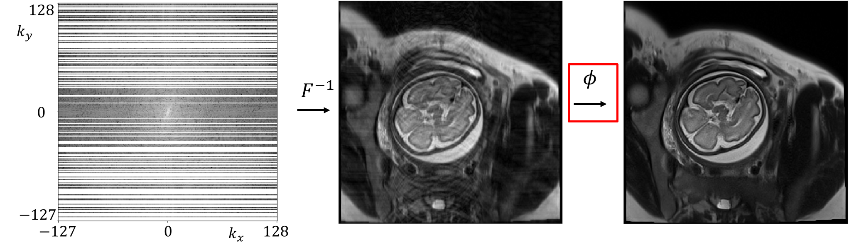


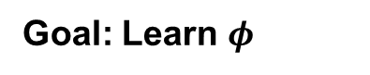
Image Reconstruction Problem
ML for Mitigating Artifacts in Fetal Imaging
Poster # 3383
Goal: Learn $φ$

Slide 4
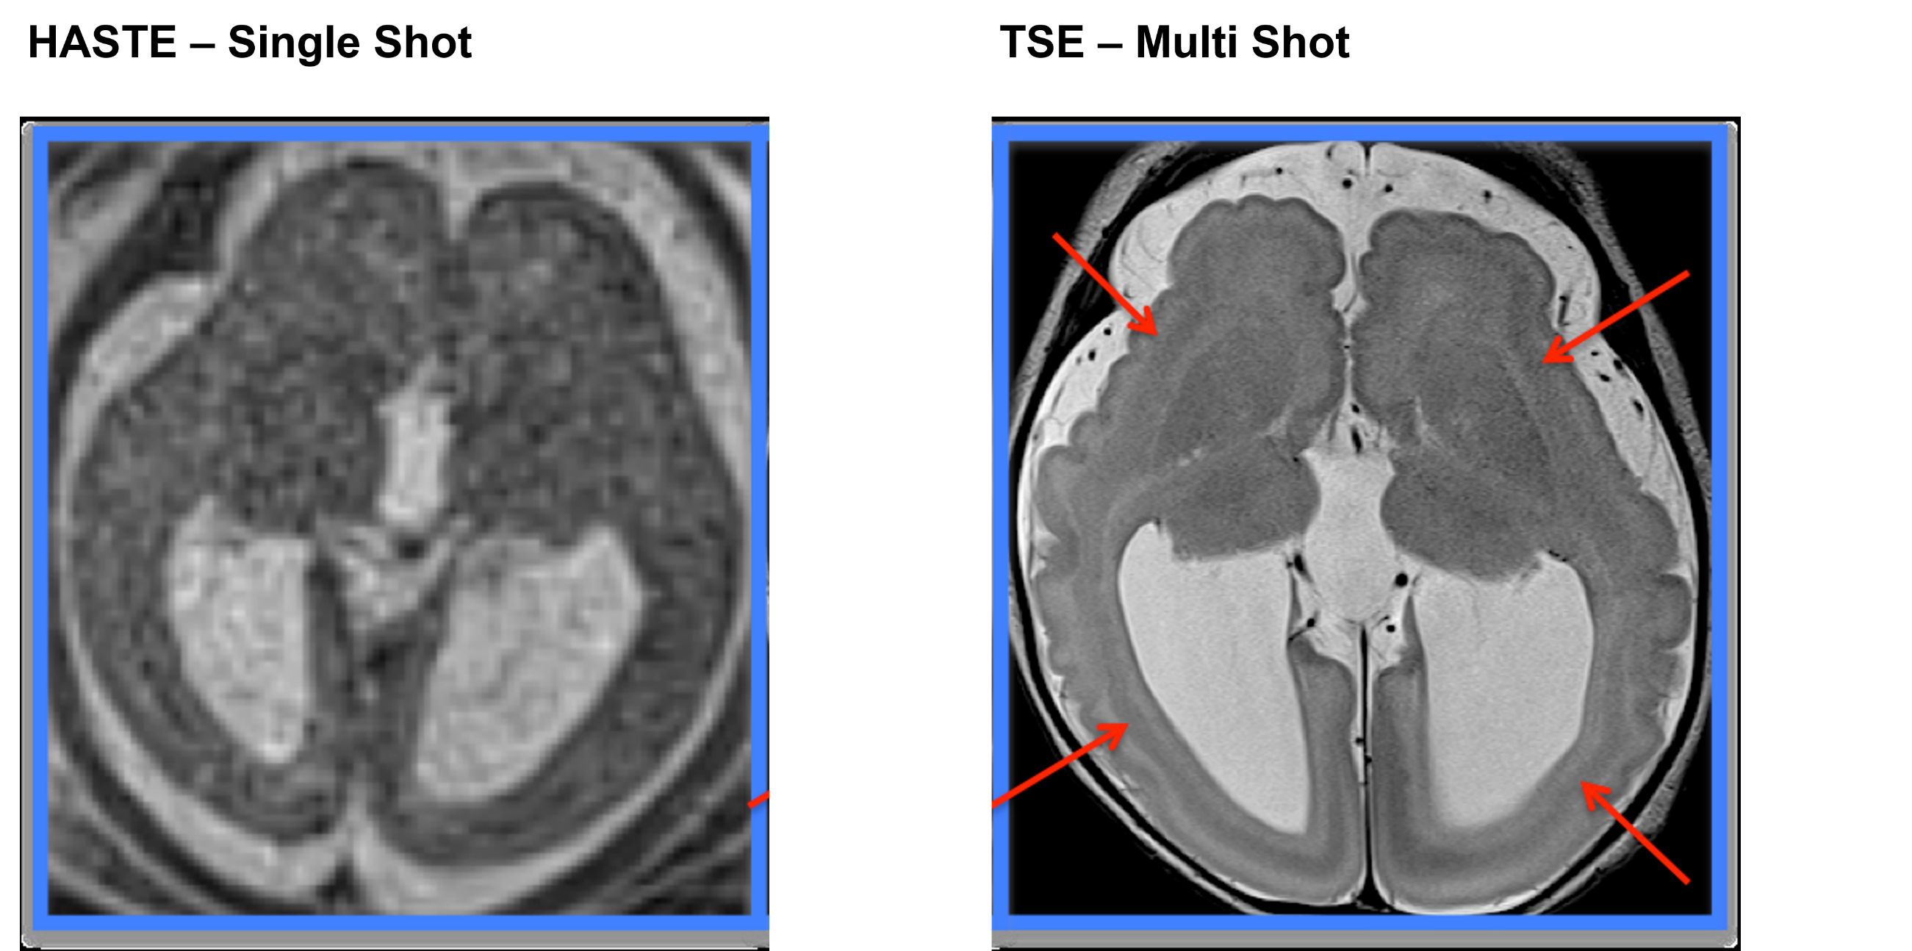
Undersampling k-space improves T2 contrast by shortening echo train length.
ML for Mitigating Artifacts in Fetal Imaging
Poster # 3383
Voxel resolution
1.2x1.2x3 mm³
0.4x0.4x2.5 mm³
Notes:
Aside from SNR issues…
HASTE time duration single shot
TSE time duration multi shot
Explain why we cannot perform TSE (Refer to the backup slides)
Other performance gains?

Slide 5
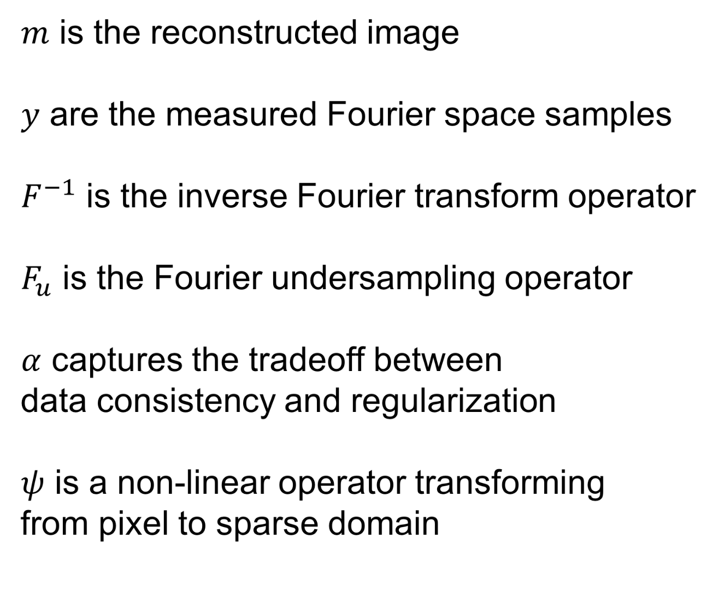
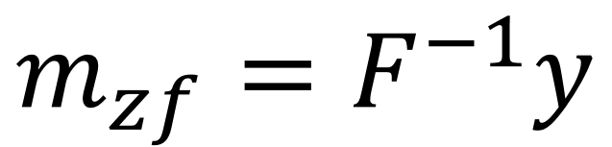
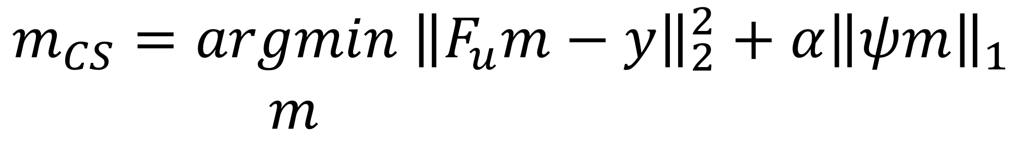
Image Reconstruction Algorithms
ML for Mitigating Artifacts in Fetal Imaging
Poster # 3383
Naïve Zero-Filled
Compressed Sensing
Lustig, Michael, David Donoho, and John M. Pauly. "Sparse MRI: The application of compressed sensing for rapid MR imaging."
Schlemper, Jo, et al. "A deep cascade of convolutional neural networks for MR image reconstruction.”

Slide 6
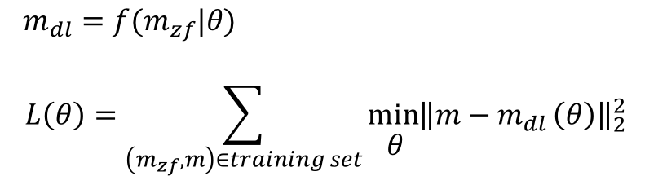
Image Reconstruction Algorithms
ML for Mitigating Artifacts in Fetal Imaging
Poster # 3383
Deep Learning
Lustig, Michael, David Donoho, and John M. Pauly. "Sparse MRI: The application of compressed sensing for rapid MR imaging."
Schlemper, Jo, et al. "A deep cascade of convolutional neural networks for MR image reconstruction.”

Slide 7
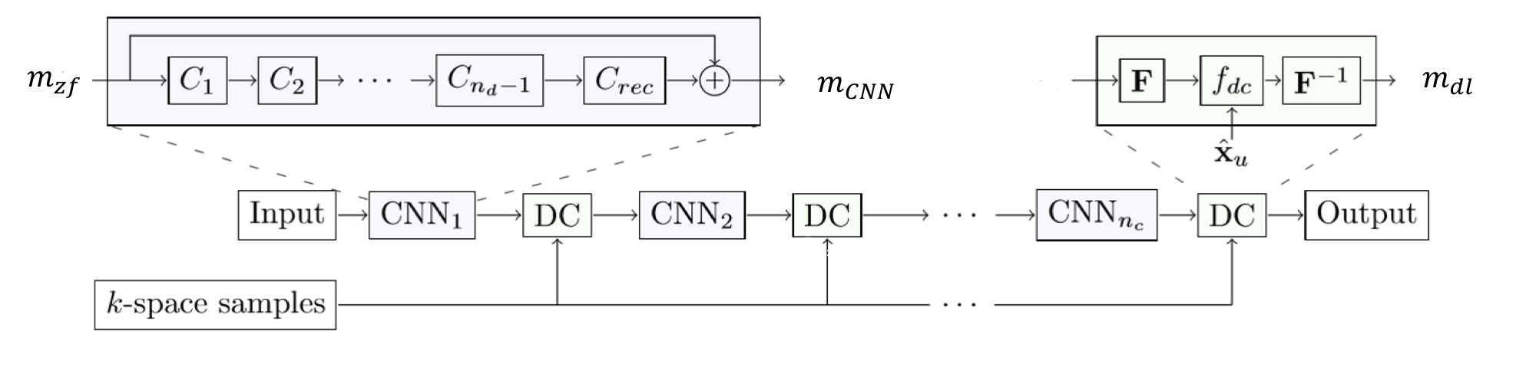
Deep Learning Image Reconstruction Architecture: Cascade of CNNs
ML for Mitigating Artifacts in Fetal Imaging
Poster # 3383
Schlemper, Jo, et al. "A deep cascade of convolutional neural networks for MR image reconstruction.”
Notes:
Explain each layer carefully
e.g., how does the data consistency layer work

Slide 8
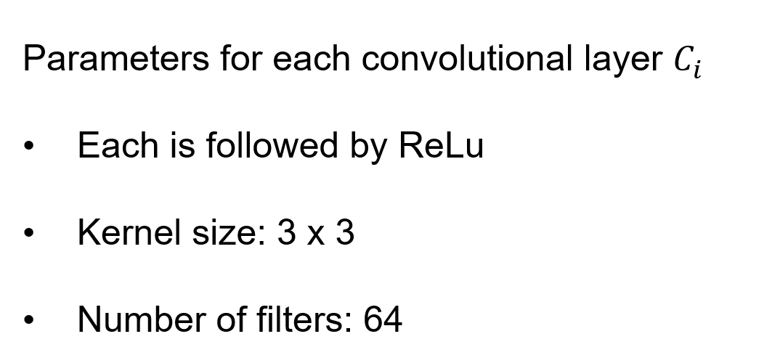
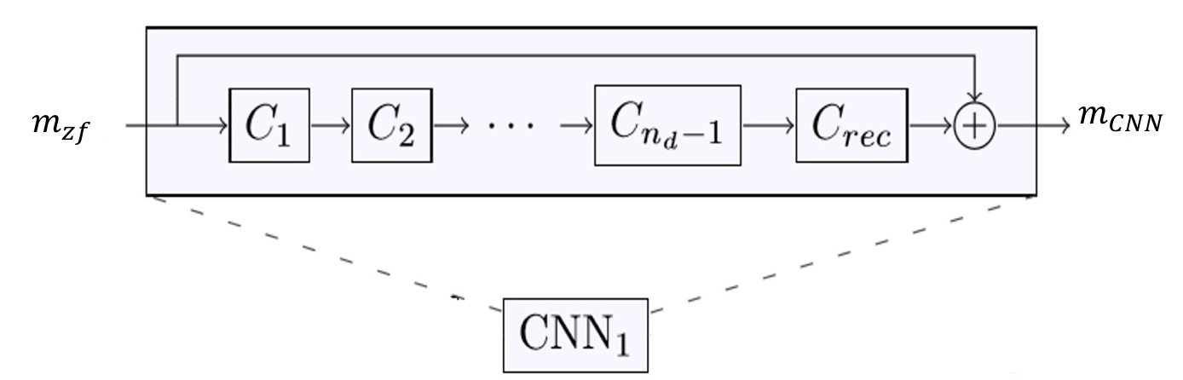
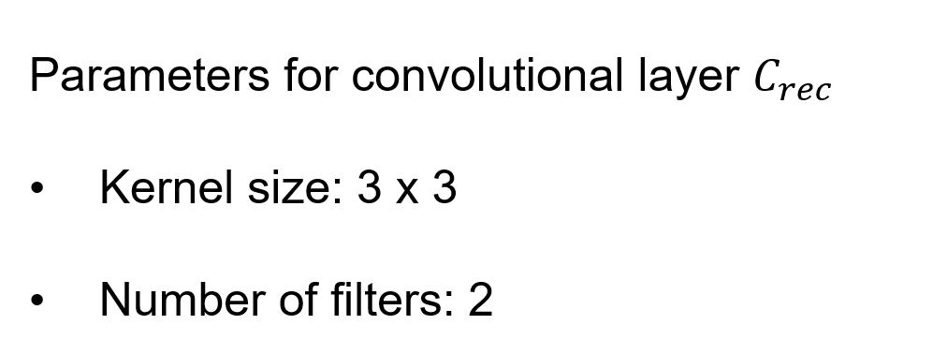
Deep Learning Image Reconstruction Architecture: CNN Module
ML for Mitigating Artifacts in Fetal Imaging
Poster # 3383
Schlemper, Jo, et al. "A deep cascade of convolutional neural networks for MR image reconstruction.”

Slide 9
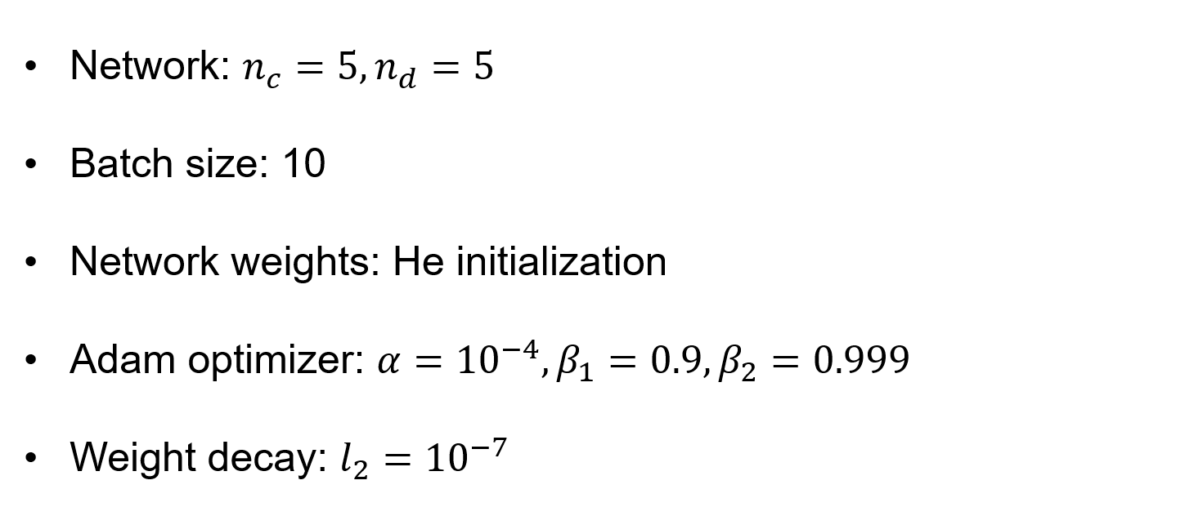
Evaluation Method: Architecture and Training Parameters
ML for Mitigating Artifacts in Fetal Imaging
Poster # 3383

Slide 10
Dataset
ML for Mitigating Artifacts in Fetal Imaging
Poster # 3383
10 scans from fetal imaging¹
Training dataset: 7 patients’ data, ~3000 images
Test dataset: 3 patients’ data, ~1000 images
Parameters for MRI
Magnitude images from vendor reconstructions of Fourier data using GRAPPA=2 HASTE and partial Fourier
Image size: 256 x 256
¹Obtained from Boston Children’s Hospital in collaboration with Dr. Ellen Grant, Director of Fetal-Neonatal Neuroimaging and Development Science Center

Slide 11
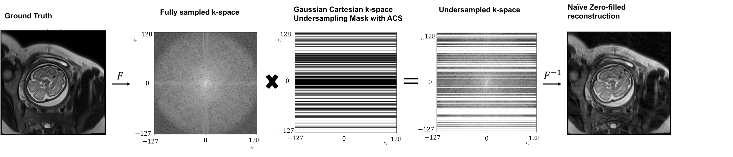
Dataset Creation via Retrospective Undersampling
ML for Mitigating Artifacts in Fetal Imaging
Poster # 3383

Slide 12
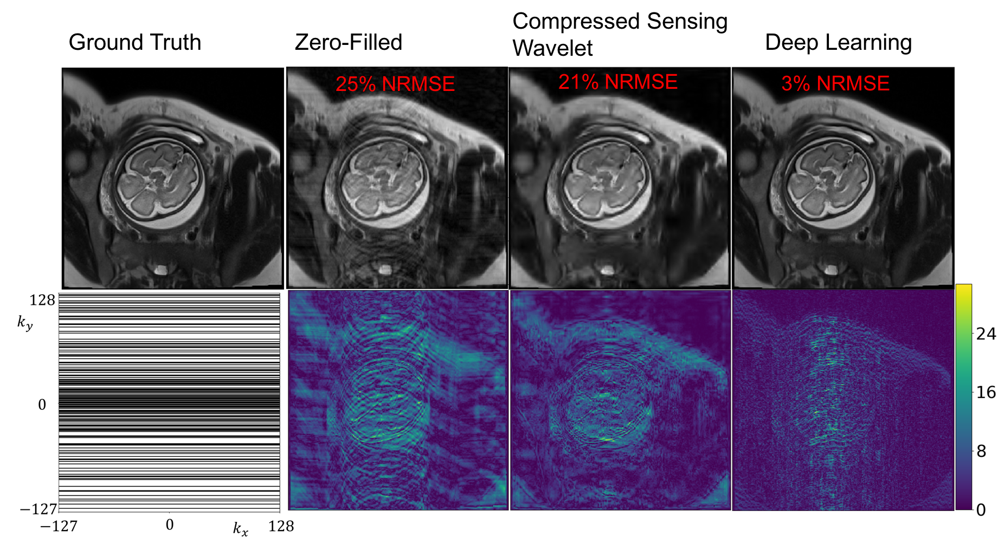
Sample Reconstruction, R=2
ML for Mitigating Artifacts in Fetal Imaging
Poster # 3383
Error (x100)
25% NRMSE

Slide 13
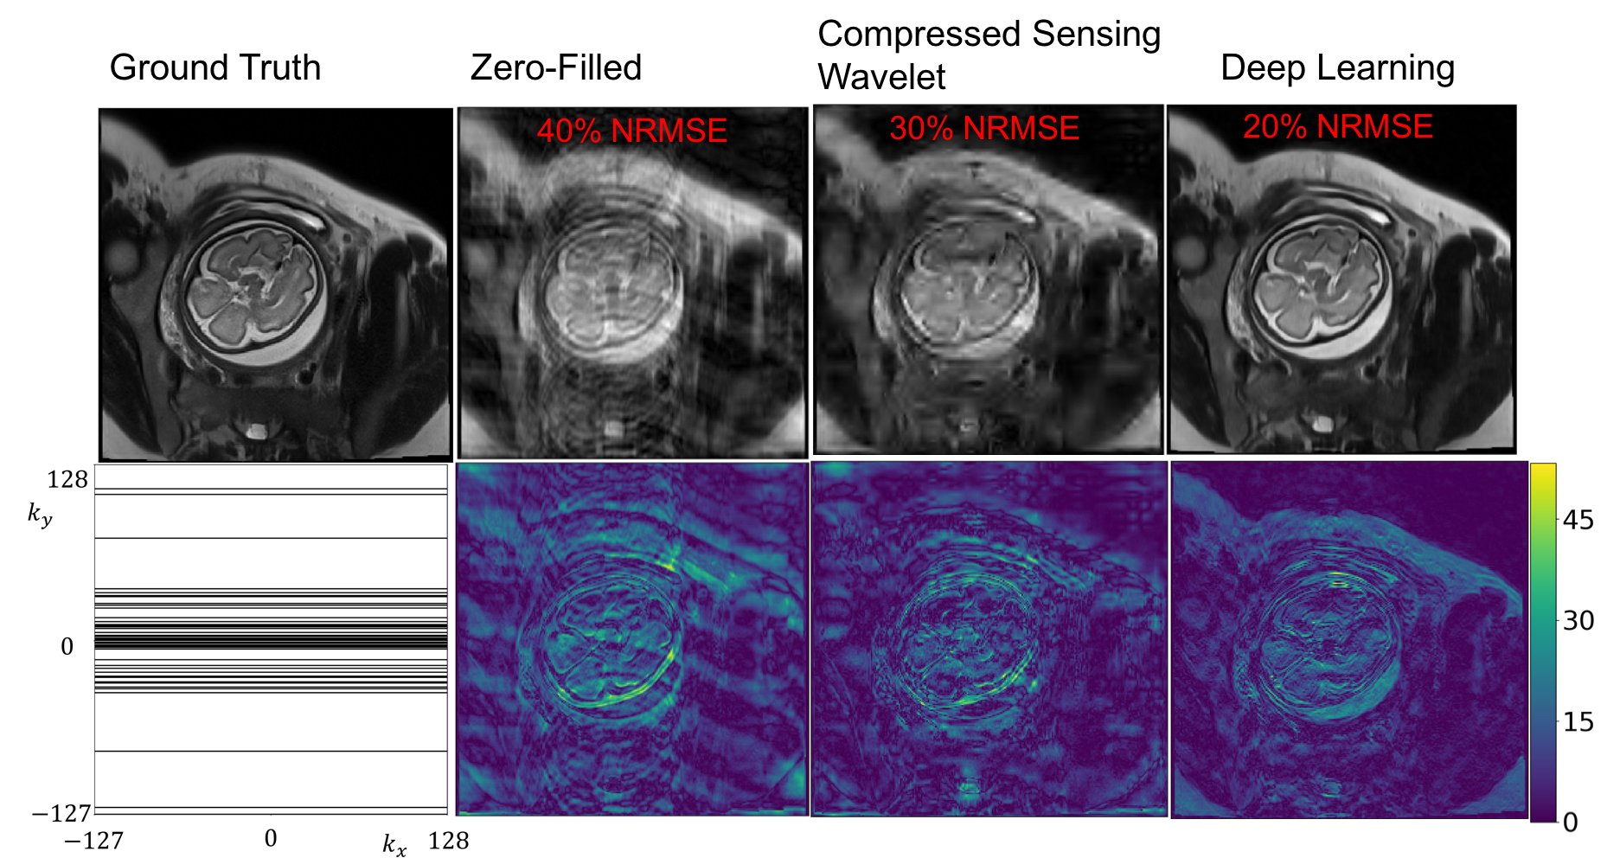
Sample Reconstruction, R=6
ML for Mitigating Artifacts in Fetal Imaging
Poster # 3383
Error (x100)
25% NRMSE

Slide 14
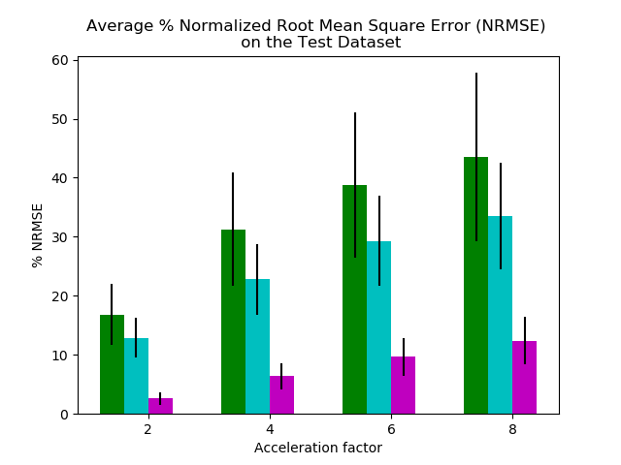
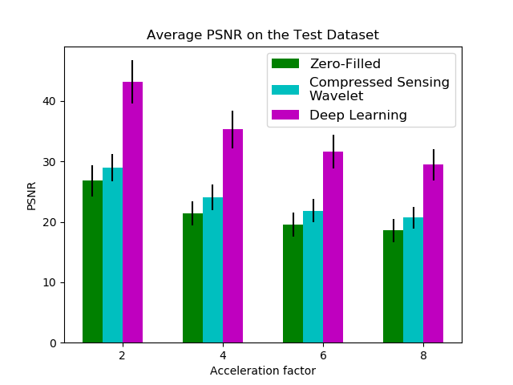
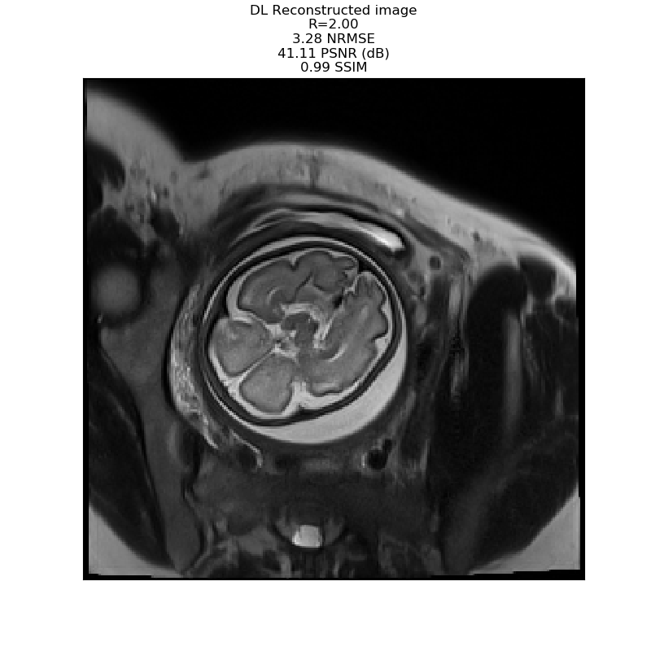
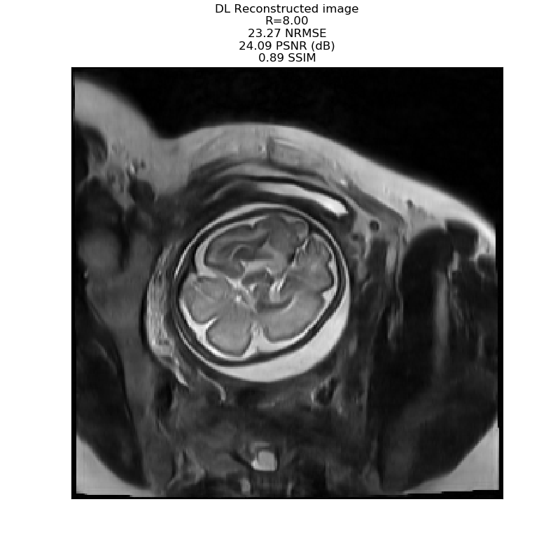
Results
ML for Mitigating Artifacts in Fetal Imaging
Poster # 3383
R=2
R=8

Slide 15
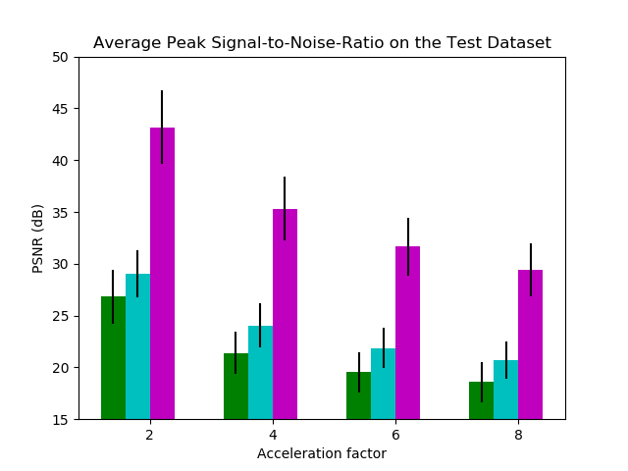
Results
ML for Mitigating Artifacts in Fetal Imaging
Poster # 3383
R=2
R=8

Slide 16
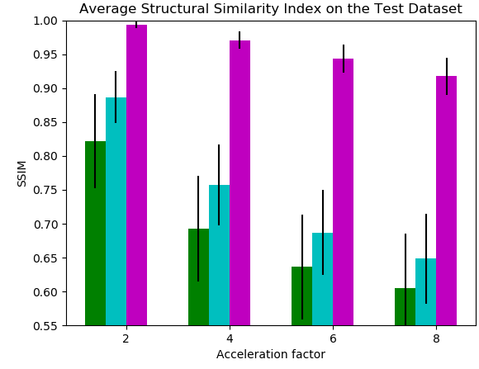
Results
ML for Mitigating Artifacts in Fetal Imaging
Poster # 3383
R=2
R=8

Slide 17
Conclusions
ML for Mitigating Artifacts in Fetal Imaging
Poster # 3383
Deep Learning reconstruction
performs significantly better than Compressed Sensing and Zero filled image reconstruction
suffers from higher residual error over high spatial frequency features with increased k-space undersampling
Based on radiologist evaluation, deep learning recons. with < 5-6% NRMSE are high quality
Future work:
Evaluate Deep Learning recon. on prospectively sampled data
Extend the Deep Learning network to
Process Volumetric data

Slide 18
Acknowledgments
ML for Mitigating Artifacts in Fetal Imaging
Poster # 3383
Borjan Gagoski, Jeffrey N. Stout, Bo Zhao, Berkin Bilgic, Ellen P. Grant, Polina Golland, Elfar Adalsteinsson
NIBIB R01EB017337; NICHD U01HD087211
EECS MIT Quick Innovation Fellowship

Slide 19
BACKUP

Slide 20
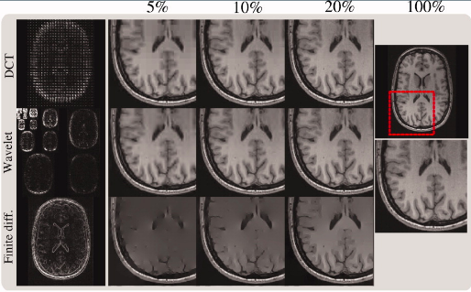
Compressed Sensing Sparsifying Transforms
ML for Mitigating Artifacts in Fetal Imaging
Poster # 3383
Lustig, Michael, David Donoho, and John M. Pauly. "Sparse MRI: The application of compressed sensing for rapid MR imaging."

